Slide 1

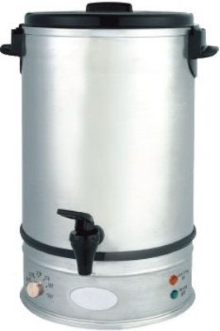
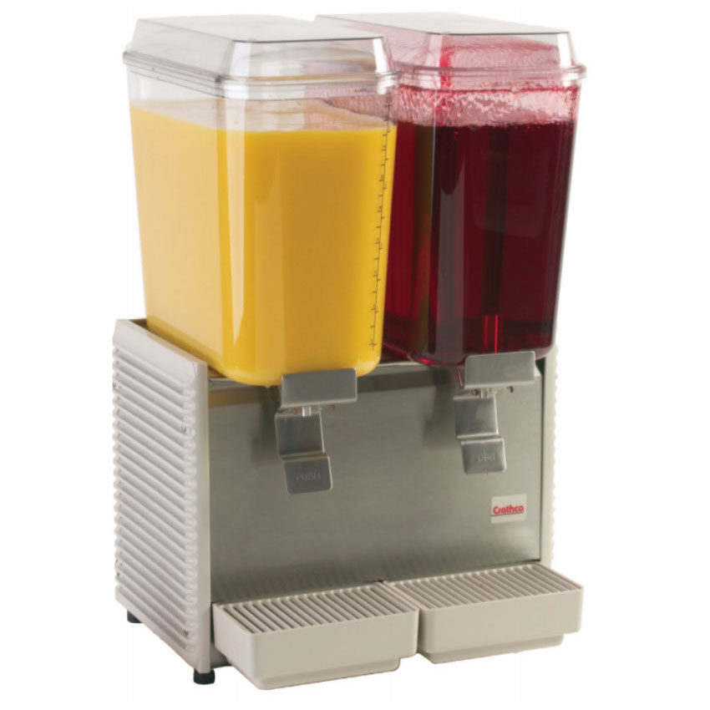
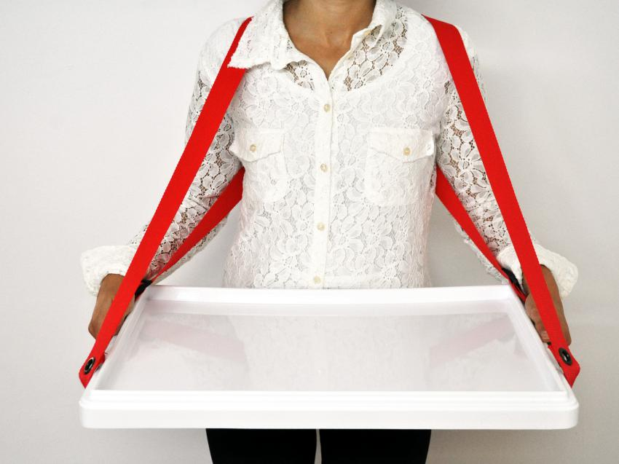
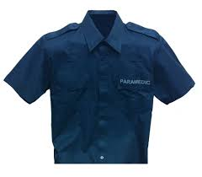
WET SAMPLING EQUIPMENTS NEEDED
DESCRIPTION | QTY | AMOUNT
SAMPLING BOOTH | 1 | 20,000.00
BOILER DISPENSER 10.7 ltrs. (capacity 10,800 ml @ 1,500g per boiler) | 1 | 5,000.00
COLD BEVERAGE DISPENSER (9,000 ml cap) | 1 | 32,000.00
TRAY | 3 | 300.00
UNIFORMS (Sampling Crew) | 2 | 1,000.00
TOTAL |  | 58,300.00

Slide 2
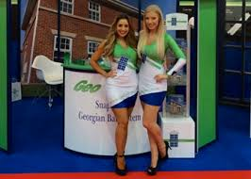
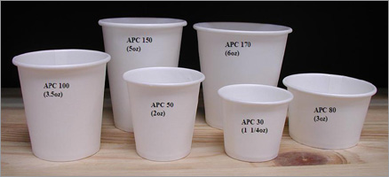
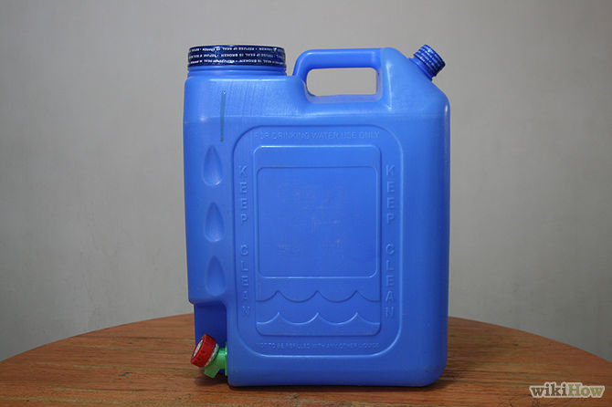
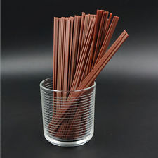
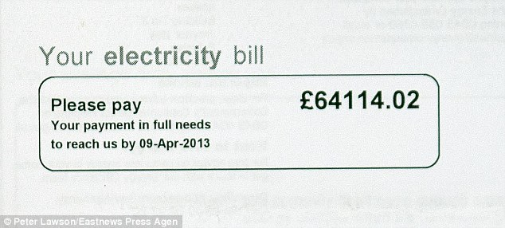
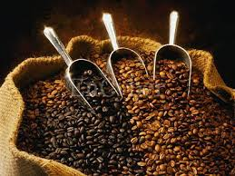
WET SAMPLING COST PER DAY
DESCRIPTION | QTY | AMOUNT
CUPS 8 oz @ 60 pcs. (71 cups at 150ml) | 240 | 600.00
WATER 5 gals | 2 | 100.00
STIRRER | 100 | 60.00
SAMPLING GIRL/PUSH GIRL @ 600/day | 2 | 1,200.00
ELECTRICITY COST |  | 300.00
COFFEE 30 gms x 10 x 24 @ 1,368/cs | 1 | 1,368.00
TOTAL |  | 3,628.00
Average of 5,000 per sampling day budget if product highlights will include Hot and cold

Slide 3
PROPOSED BUDGET FOR WET SAMPLING
DESCRIPTION | QTY | AMOUNT
20 distributors @ 2 sets of wet sampling equipments and booth @ 60,000/set | 40 | 2,400,000.00
20 distributors for 50 sampling events a year @ 5000/sampling cost | 1000 | 5,000,000.00
TOTAL |  | 7,400,000.00

